Slide 1
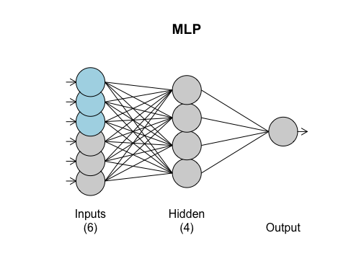
RNN Analysis of Sunspot Data
Predicting Melonoma using Sunspot and previous Melonoma data.
sstrain = ts(ss$Melanoma[1:29],start= c(1936,1),frequency = 1) sstest = ts(ss$Melanoma[30:37],start= c(1965,1),frequency = 1) set.seed(2) melonomatrain = data.frame(ts(ss$Sunspot,start= c(1936,1),frequency = 1)) fit.mlp = mlp(sstrain, hd.auto.type = "elm", xreg = melonomatrain) fit.mlp
## MLP fit with 4 hidden nodes and 20 repetitions. ## Series modelled in differences: D1. ## Univariate lags: (1,2,3) ## 1 regressor included. ## - Regressor 1 lags: (1,2,3) ## Forecast combined using the median operator. ## MSE: 0.003.
plot(fit.mlp)

Slide 2
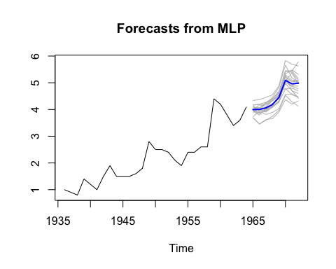
Melanoma Forecasting with Sunspot Data
The forecast average was stellar.
ASE = .07 and MSE .003

Slide 3
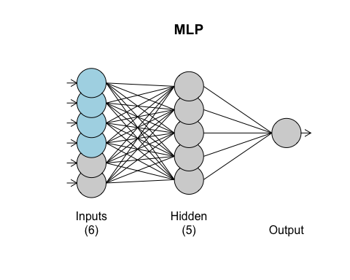
RNN Analysis of Pollution Data to Predict Mortality
train = ts(pol$cmort[1:498],start=1,frequency = 1) test = ts(pol$cmort[499:508],start=499,frequency = 1) set.seed(2) regs = data.frame(temp=ts(pol$temp,frequency = 1),part =ts(pol$part,frequency = 1)) fit.mlp = mlp(train, hd.auto.type = "elm", xreg = regs) fit.mlp
## MLP fit with 5 hidden nodes and 20 repetitions. ## Univariate lags: (1,2) ## 2 regressors included. ## - Regressor 1 lags: (1,2,4) ## - Regressor 2 lags: (2) ## Forecast combined using the median operator. ## MSE: 22.0032.

Slide 4
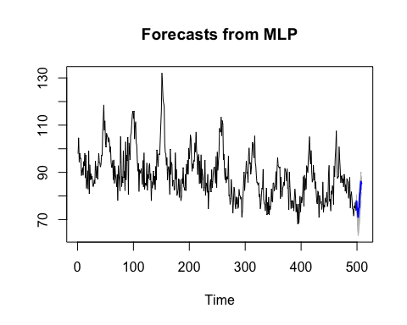
Mortality Forecasts with Pollution Data
ASE 30.19683
MSE 22.02

Slide 5
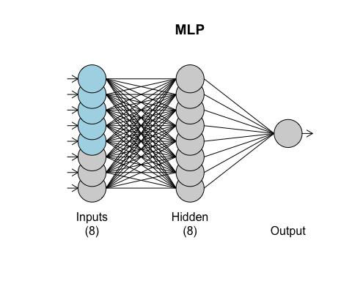
Google Stock Price Predictions using RNN
getSymbols("GOOGL”
googl = GOOGL$GOOGL.Close z <- fortify.zoo(GOOGL, name = "Date") train = ts(z$GOOGL.Close[1:(nrow(z)-10)],start=1,frequency = 1) test = ts(z$GOOGL.Close[(nrow(z)-10):nrow(z)],start=(nrow(z)-10),frequency = 1) , src = "yahoo", from = start, to = end)
regs = data.frame(volume = ts(z$GOOGL.Volume, frequency = 1),high = ts(z$GOOGL.High,frequency = 1),low = ts(z$GOOGL.Low,frequency = 1)) set.seed(2) fit.mlp = mlp(train, hd.auto.type = "elm",xreg=regs) fit.mlp
## MLP fit with 8 hidden nodes and 20 repetitions. ## Univariate lags: (1,2,3) ## 3 regressors included. ## - Regressor 1 lags: (1) ## - Regressor 2 lags: (1,3,4) ## - Regressor 3 lags: (3) ## Forecast combined using the median operator. ## MSE: 202.4603.

Slide 6
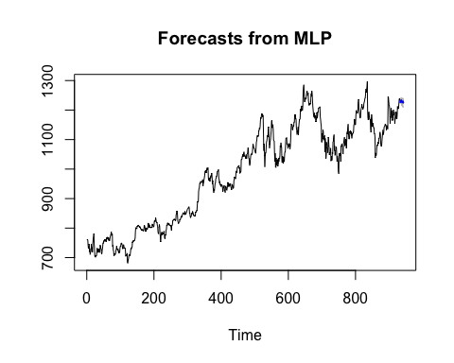
Stock Forecasts
ASE 84.28325
MSE 202.5

Slide 7
Key Takeaways
I wished there was a little bit more time spent on the RNN side of things since it appears as if RNNs are superior in their modeling abilities to traditional time series analysis. Alternatively, have you considered a Time Series 2 course?

